Slide 1

Cansat in Russia
Team name is KYYRAI
Performed by student of 11th grade
Popov Vladimir
Teacher: Nyurgun Maratovich
Yakutsk city – 2019 year

Slide 2
Team list:
Alternate
team leader
(Marat Efimovich)
Programmer
Antonov Alexey
Team leader
(Popov Vladimir)
Electronic
Popov Vladimir
Scientific leader
(Nuyrgun Maratovich)
Mechanic

Slide 3
Designer
Satellite Cansat consists of:
Mechanical frame
Three boards
Charge MC Atmega128
Board of science load (temperature sensor, pressure and accelerometer.
Board of radio-module(transceiver) , frequency – 2,4 -2,525 GHz.

Slide 4

Missions of my spacecraft
My main mission is a ecological monitoring.
I will be watching the concentration of dust in the air.
My device measures the amount of dust in the air (mg/m^3)
I want to make our city ecologically safe.

Slide 5
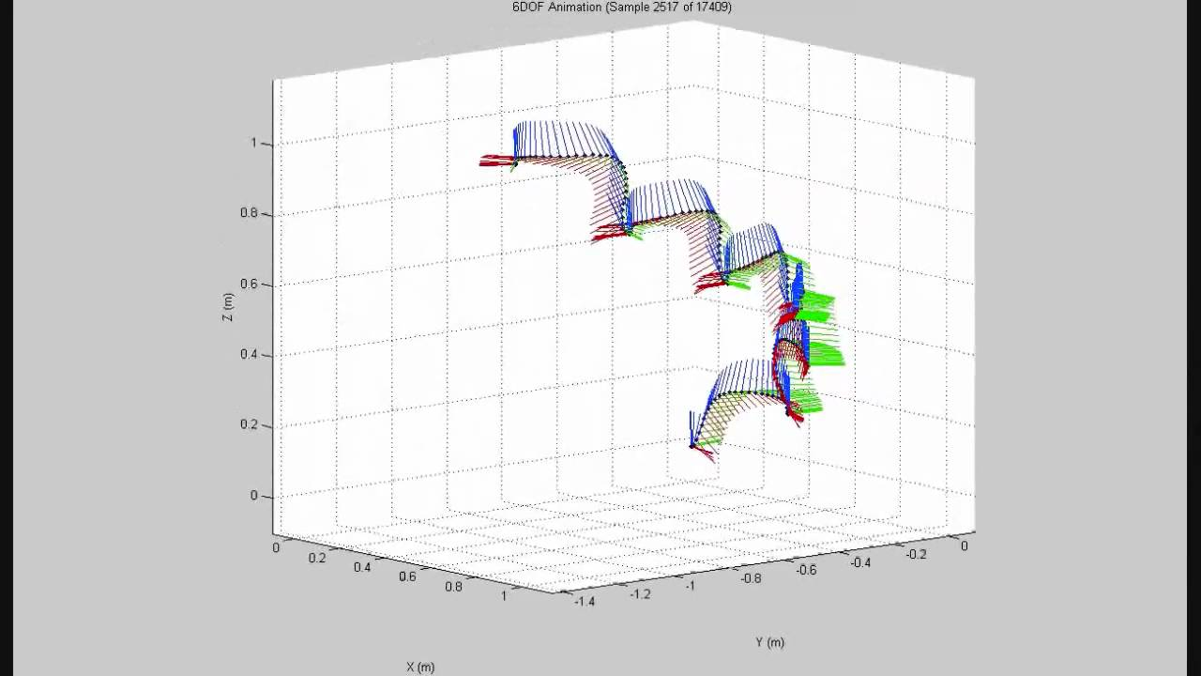
Our missions:
Measurement of temperature and pressure on the descent path.

Slide 6
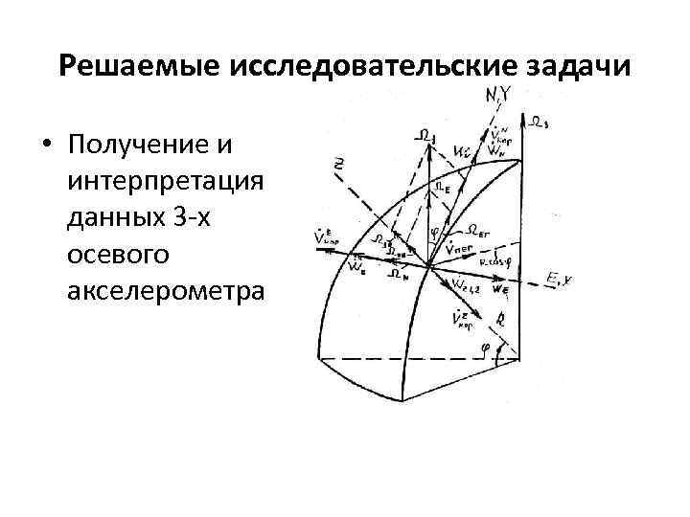
2. Data acquisition and interpretation with 3-axis accelerometer.

Slide 7
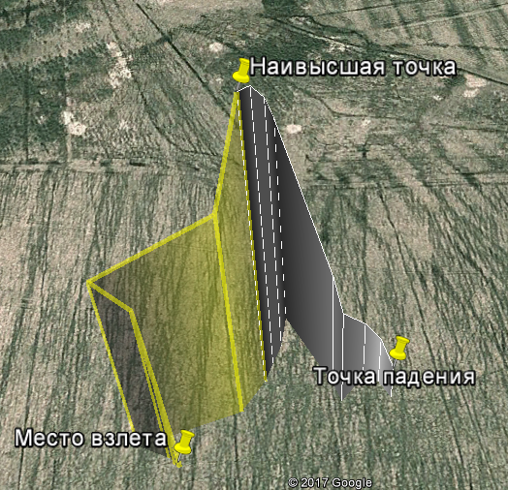
3. Construction of the trajectory of the satellite descent from the data obtained.

Slide 8
4. Humidity measurement

Slide 9
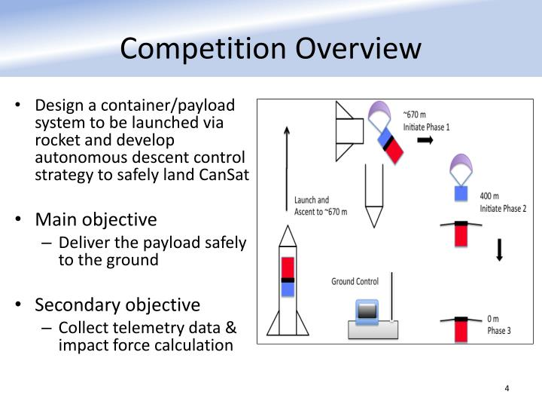
5. Surveying the area

Slide 10
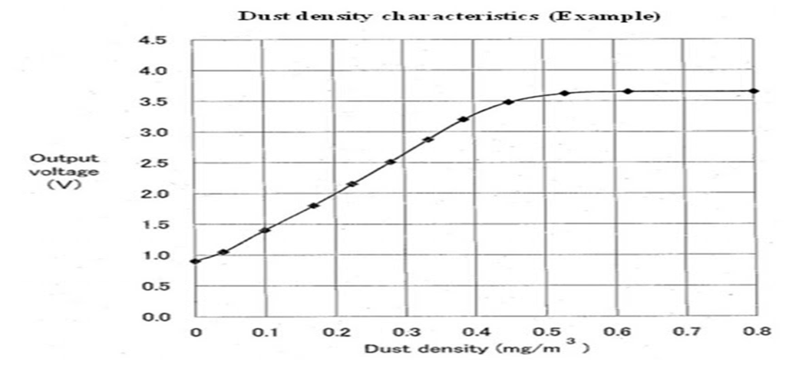
6. Measuring the amount of dust

Slide 11
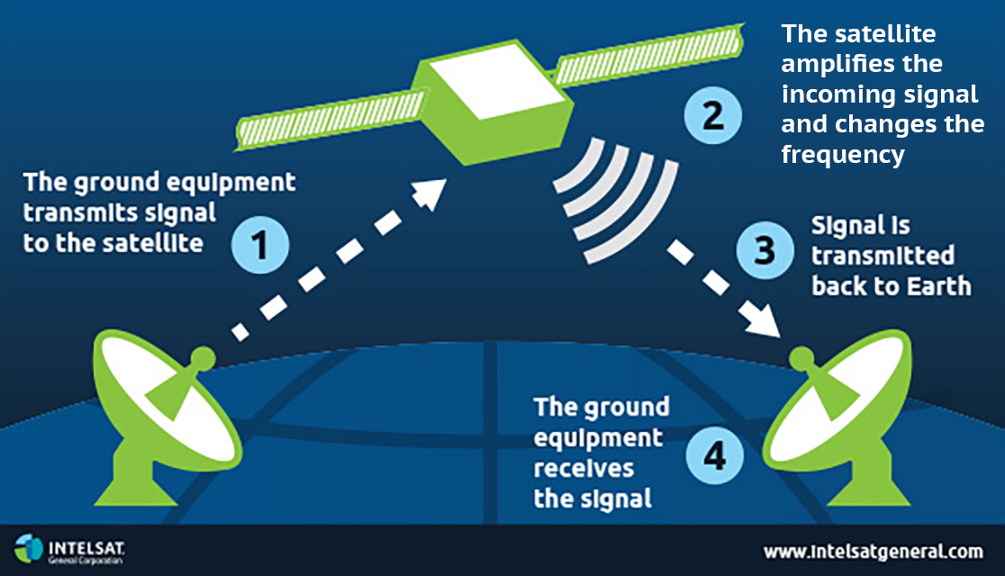
7. Transmissions of telemetry over the radio channel to the ground receiving station.

Slide 12
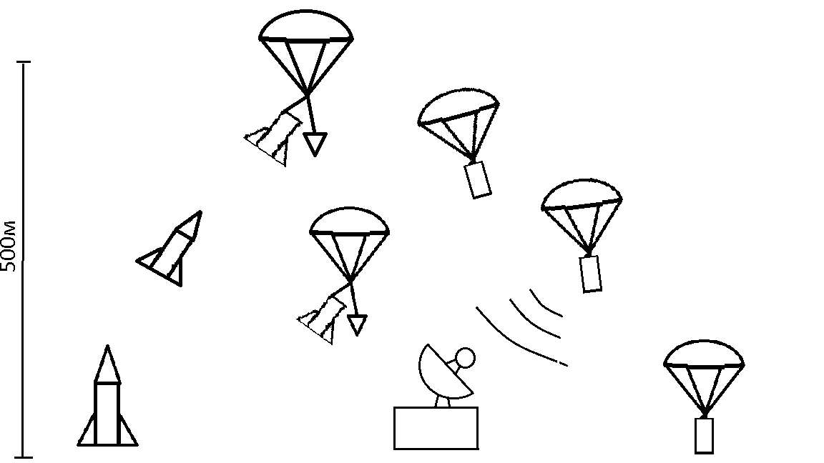
Flight diagram

Slide 13
The block-diagram of the satellite:
Data
Power
Gps-module
Microcontroller
(Atmega128)
Camera
Battery
Press/Temp
Ground station
receiver
Accelerometer
antenna
antenna
receiver
Dust sensor
PC

Slide 14
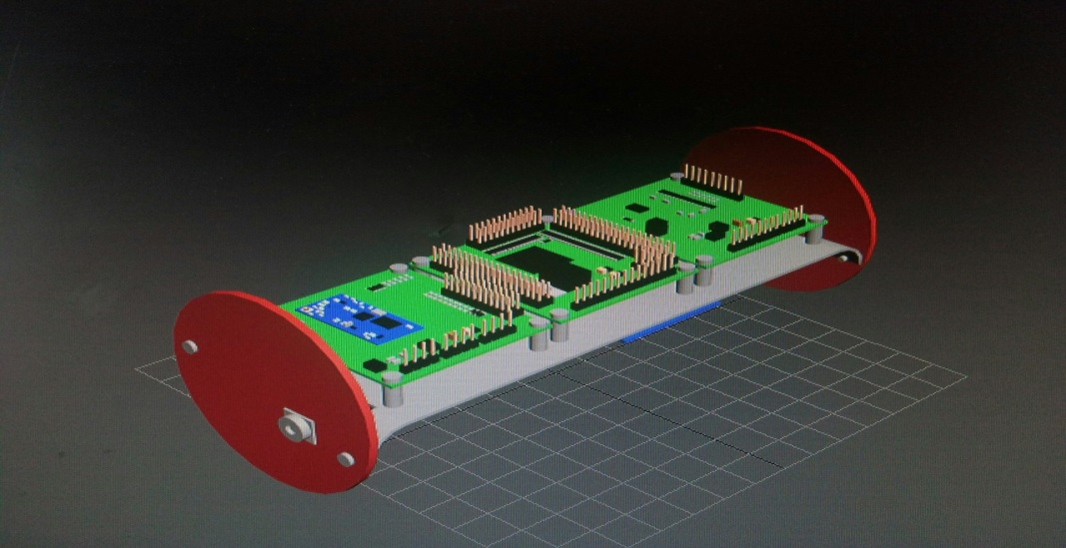
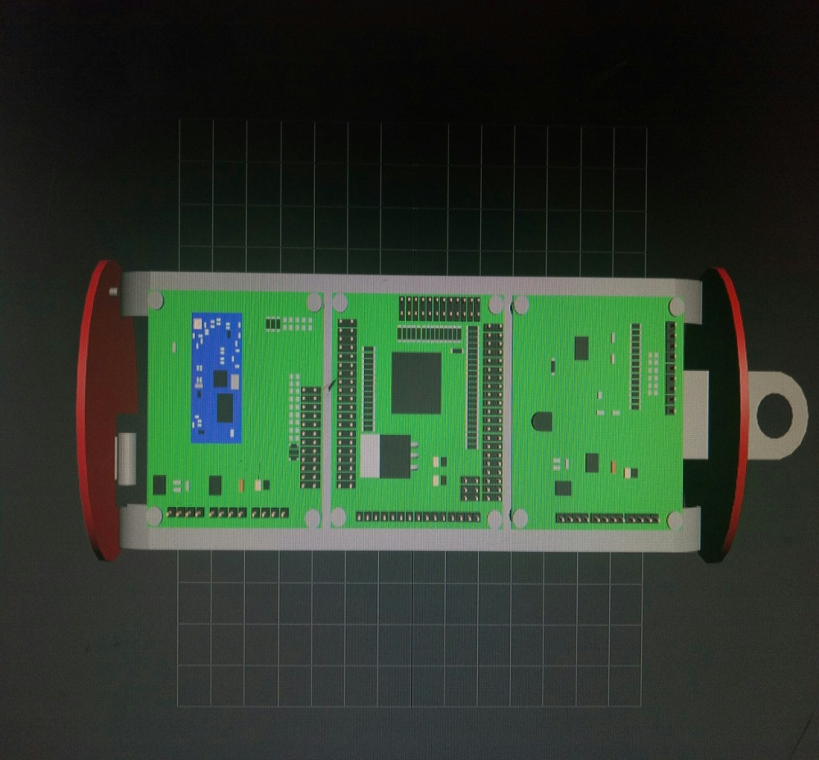
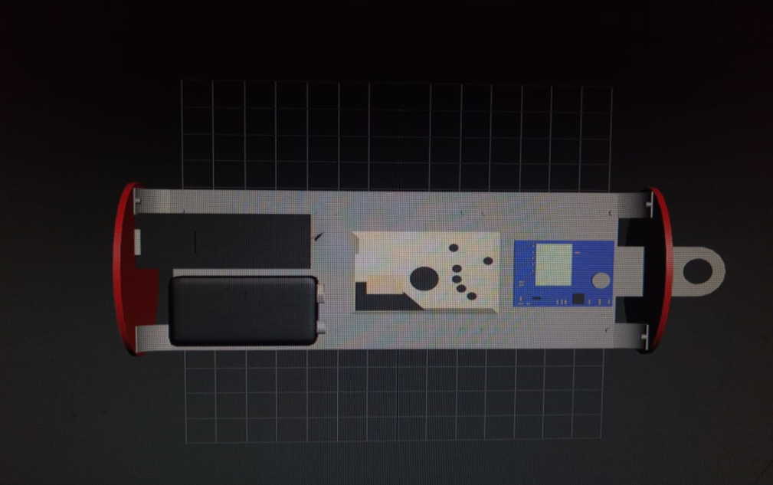
Project work
Camera lens
MC board Atmega128
Radio module board
Sensor board
GPS-module
Dust sensor
Battery
Camera

Slide 15
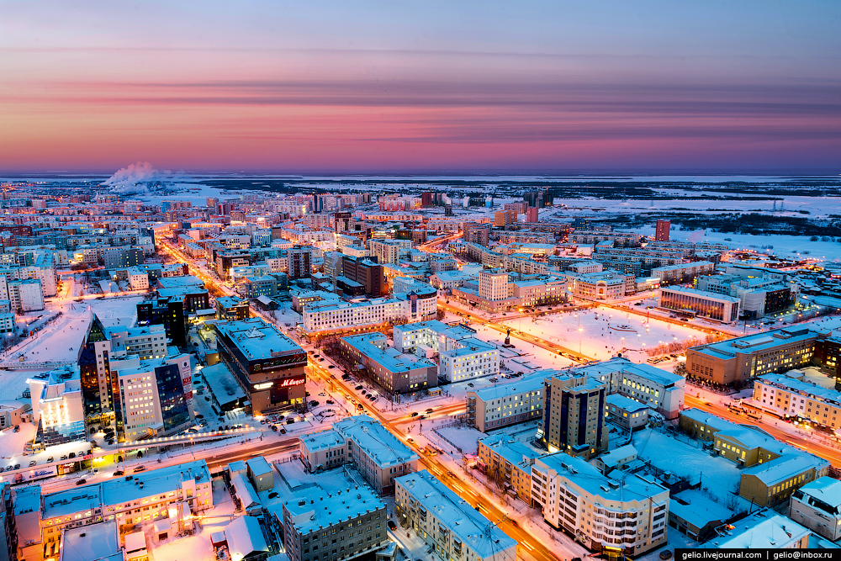
Monitoring of dust concentration:
X
Y
F
Z
W

Slide 16
What we used:
We use C language for programming our device.
Our device differs from the standart in that it has a built-in dust sensor, camera and Gps-module.

Slide 17
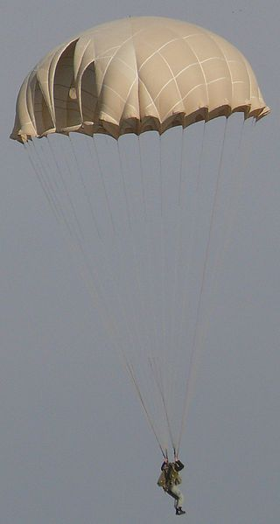
System of safety:
Fc=mg-ma
r
Hemisphere type system of safety
F= the force of air resistance
r = radius of parashute
F=mg

Slide 18
The calculation of the parachute canopy:
m= 0.35 кг– weight of the device
g= 9.8 м/с2 - acceleration of gravity
cd= 1.2– drag coefficient
ρ=1.2754 кг/м3 – air density
v=8 м/с – the speed of descent
r= 15 см – the radius of the base of the parachute
D= 30 см – the diameter of the parachute.
F= the force of air resistance.
Hemisphere type system of safety

Slide 19
Device | Voltage (V) | Amperage(А) | Power(W)
GPS NEO-6M | 3,30 | 0,10 | 0,33
BMP280- | 5,00 | 0,00 | 0,01
GP2Y1010AU0F | 5,00 | 0,02 | 0,10
DS18B20 | 5,00 | 0,00 | 0,01
Atmega128 | 5,00 | 0,02 | 0,10
ADXL345- | 3,60 | 0,00 | 0,00
E01-ML01SP2 | 3,60 | 0,02 | 0,10
DHT11 | 5,00 | 0,20 | 0,10
Итог | 35,5 | 0,36 | 0,75

Slide 20
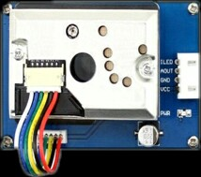
Dust sensor - GP2Y1010AU0F
Supply voltage: 5-7V operating temperature: -10-65 ° C consumption Current: 20mA max minimum detectable particle Size: 0.0008 mm Sensitivity: 0.5 V / (0.1 mg / m3)
clean air voltage: 0.9 V
storage Temperature: -20 ~ 80 ℃
Size: 46mm × 30mm × 17.6 mm

Slide 21
The Sharp GP2Y1010AU0F optical dust sensor is effective in detecting very fine particles, and is commonly used in air purification systems. The infrared diode and phototransistor are located diagonally and contribute to the detection of reflected light of dust particles in the air. The sensor has a very low power consumption (20 mA maximum, 11 mA average). The output signal of the sensor is an analog voltage proportional to the measured dust density

Slide 22
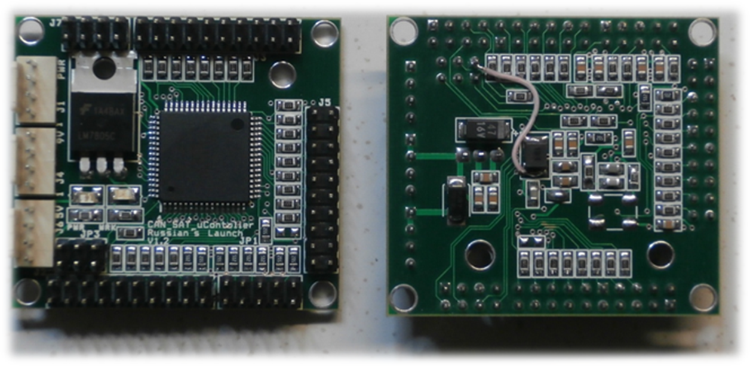
Microcontroller
Atmega128:
128KB reprogrammable flash memory
4KB flash memory for data
4KB of RAM
The supply voltage of 5V

Slide 23
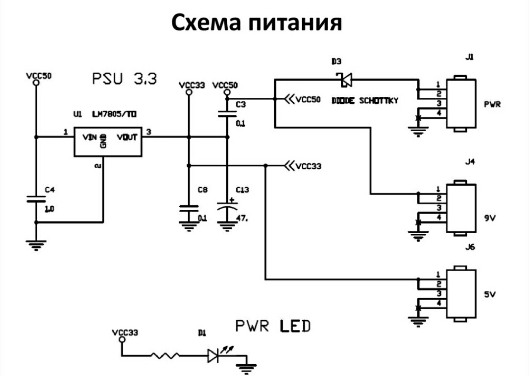
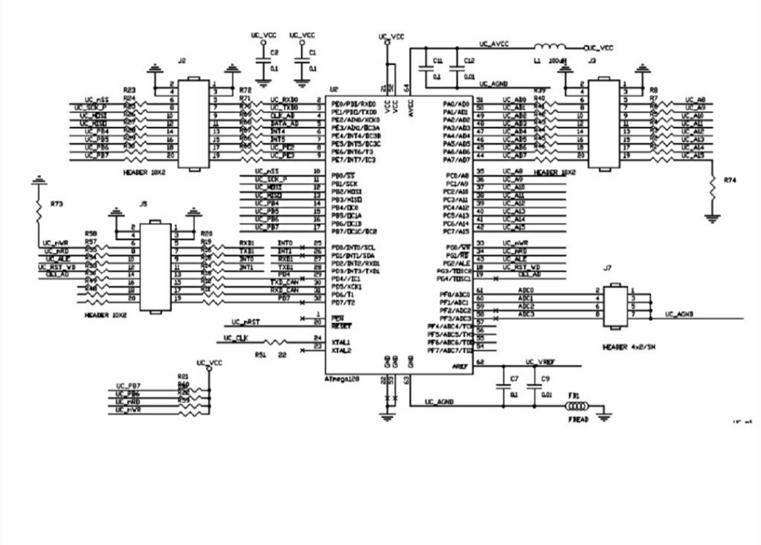
Microcontroller:
- Основные аппаратные интерфейсы
- TWI (Two-wire Serial Interface)
- USART (Universal Synchronous and Asynchronous serial Receiver and Transmitter
- The 16-bit Timer/Counter
- 53 Programmable I/O Lines

Slide 24
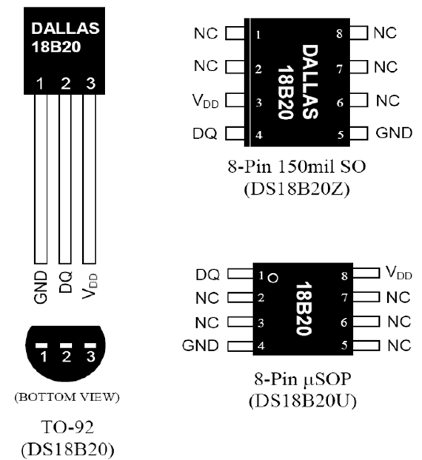
Temperature sensor:
Calibrated digital thermometer with 9 to 12 bit resolution (resolution 0.0625 With) Communicates over the 1-Wire bus and thus can be as the only device on the line TC and work in a group Supply voltage 3 to 5.5 V Measurement accuracy +-0.5 S in the range from-10S to + 85S To start the measurement, you must submit the start command (0x44) After the conversion, the received data is stored in the 2-byte temperature register in the RAM and the DS18B20 returns to the inactive state. Maximum measurement time 750ms

Slide 25
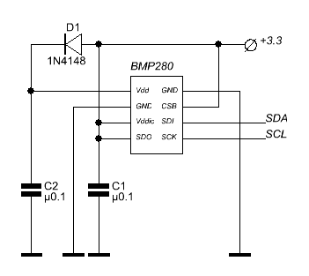
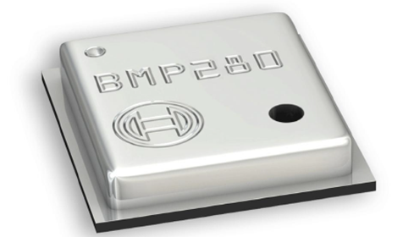
Pressure sensor:
Module supply voltage: 3.3 V or 5V DC (both levels are supported). Current consumption: up to 2 mA during measurements (depends on accuracy mode). Current consumption: up to 0.2 mA in standby mode. Measured pressure: 30 '000 to 110'000 PA (resolution 0.16 PA) Measured temperature: 0 to +65 °C (resolution 0.01°C) I2C bus operating frequency: up to 3.4 MHz. The address of the module on the I2C bus: 0x77. Logic level "1" on the I2C bus: 0.7*Vcc to Vcc (where Vcc is the supply voltage of the module) Preparation for the first start after power supply: at least 2 MS. Operating temperature: -40 ... +85 °C Dimensions: 30x30 mm

Slide 26
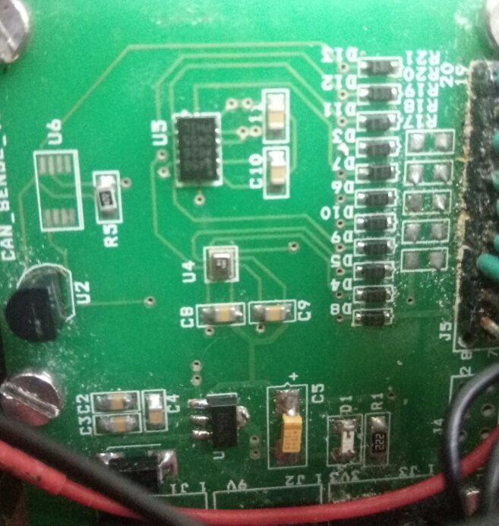
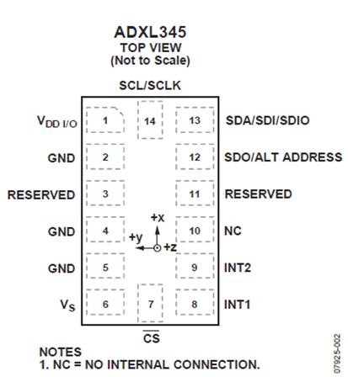
Accelerometer ADXL345:
Supply voltage from 2 to 3.6 volts Current consumed in the operating mode from 40 to 150 microA, depending on the polling frequency Resolution from 10 to 13 bits 3 axis accelerometer Operating temperature range -40 to + 85 degrees Celsius Digital interfaces SPI (three - or four-wire) and I2C Detection of events: push, double push, free fall, the presence of activity along the axes, the lack of activity 2 programmable event outputs The LGA package measuring 3×5×1 mm Shock resistant with accelerations up to 10000G

Slide 27
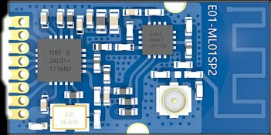
Radio-module E01-ML01SP2 :
[IC]: nRF24L01P
[Frequency]: 2.4 ~ 2.525 GHz
[Power]: 20 dBm
[Distance]: 1.8 km
[SPI] interface
[Introduction]: E01-ML01SP2 is based on the original imported nrf24l01p Nordic form in Norway. And equipped with a 20 dBm power amplifier chip imported from the US, through which the transmission power reaches 100mW (20 dBm). Professional hardware design allows the use of small size module, which is convenient for all kinds of built-in sensors.

Slide 28
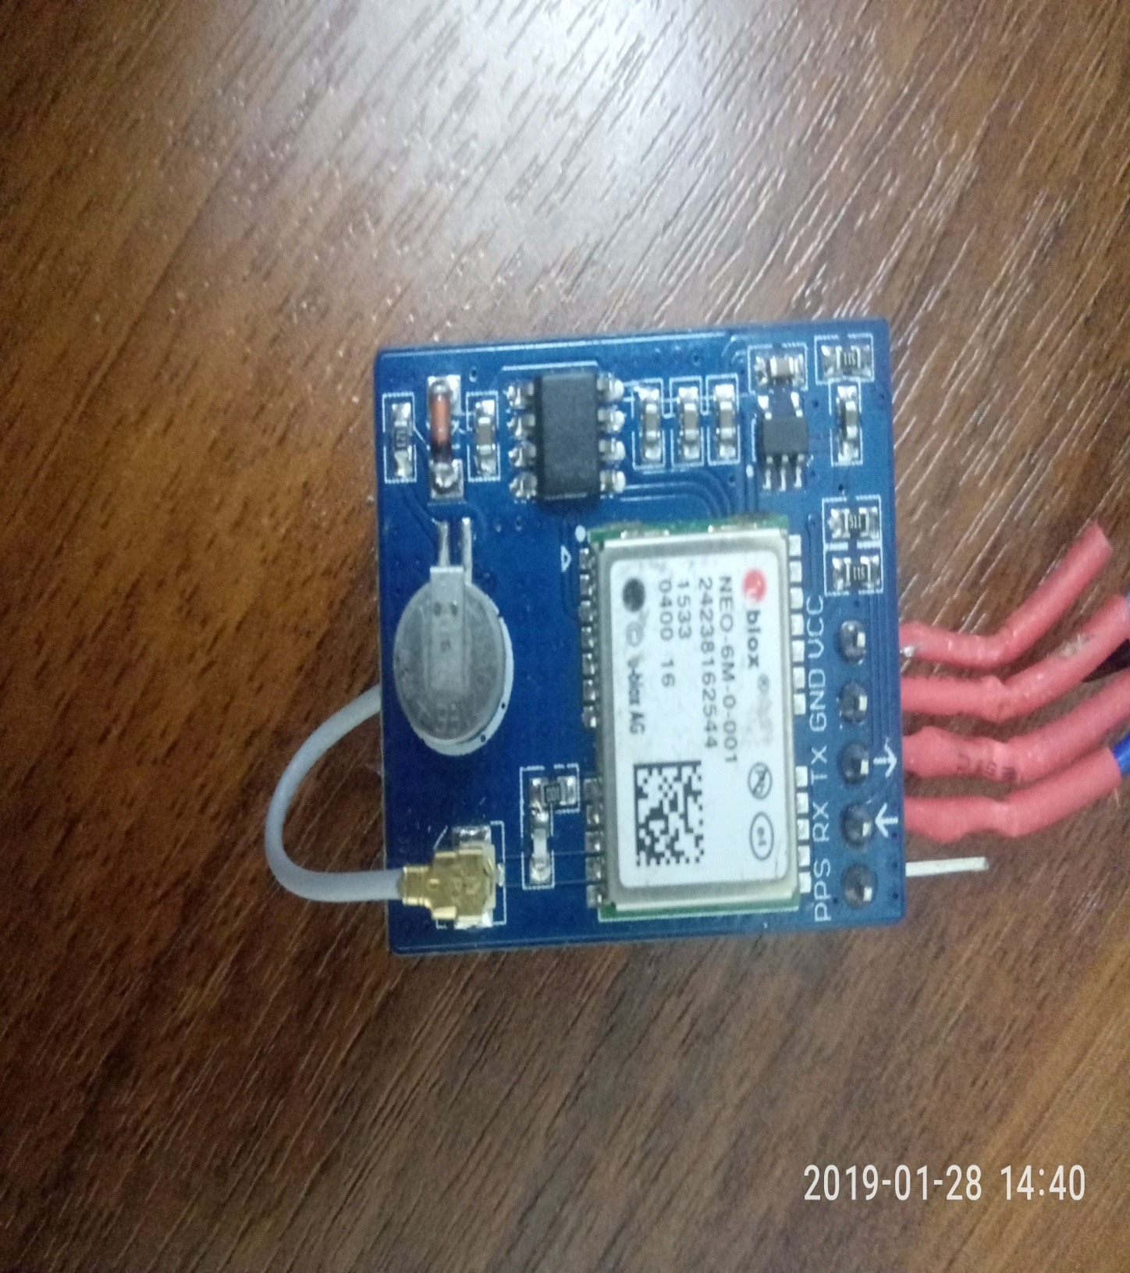
Gps-module NEO-6M:
Supply voltage: 3-5V
Positioning accuracy: up to 5m
"Hot start": 1 s
Tracking sensitivity : -162 dBm
Location update rate: 5Hz
Temperature range: -40 to 85°C
Antenna size: 18x18 mm Module size: 22x30x13mm

Slide 29
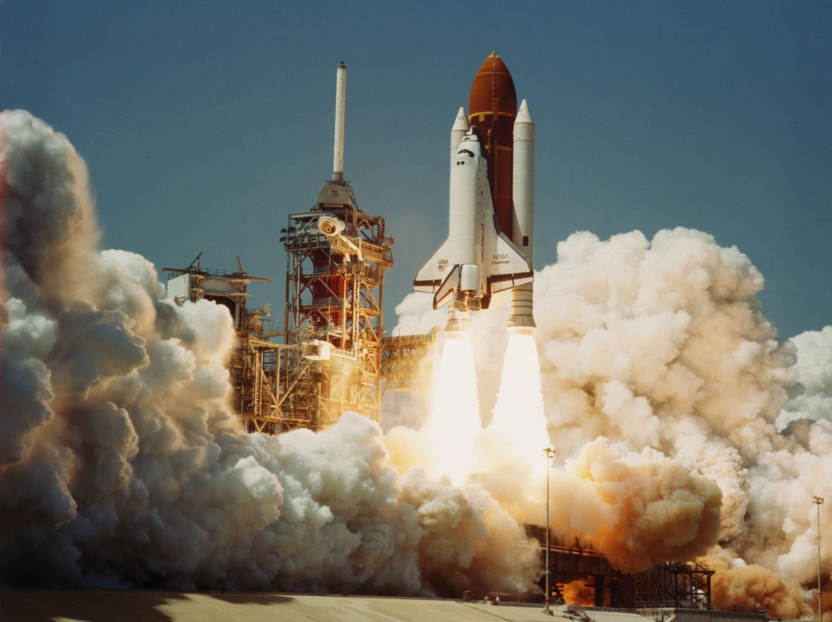
Thanks for waching!
Спасибо за внимание!
Кербуккутун иhин махтал!
Gracias por su atención!

